Slide 1
Using R to Promote Data Interoperability in the Atmospheric Science Community
Josh Roberti, Robert Lee
Cody Flagg, Lee Stanish
10 January 2017
Austin, TX
Annual AMS Conference

Slide 2
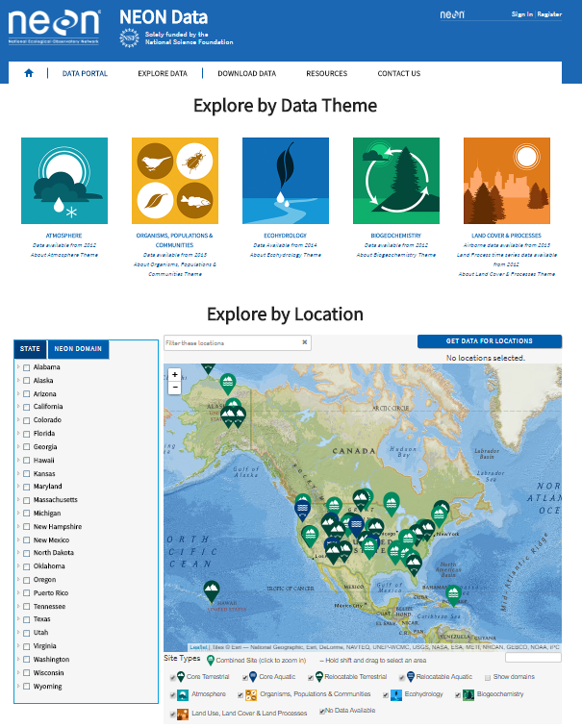
“NEON?... I’ve never heard of it”
Continental-scale ecological Observatory
Open-access data, resources and infrastructure
30-year time Observatory
Standardized measurements
Enable understanding and prediction of the effects of human activities on ecology

Slide 3
NEON data commissioning
Instrumented Systems (IS) Commissioning examines NEON data health by:
Verifying data quantity (greater than 95% available over a two month period)
Verifying data validity with internal quality reporting (greater than 90% pass QC tests)
Examining the performance of underlying infrastructure (correct boom orientation, health of data loggers)
Examining correlations between NEON data and data from nearby non-NEON sites
Does nearby tower monitor same phenomena as NEON?
Was nearby tower active during same dates as NEON tower?
Is there a tower nearby specified NEON site?
Major
time
sink
Comparable temporal resolution of both datasets?
Does nearby tower have similar elevation?
How do I download and organize these data for comparison?

Slide 4
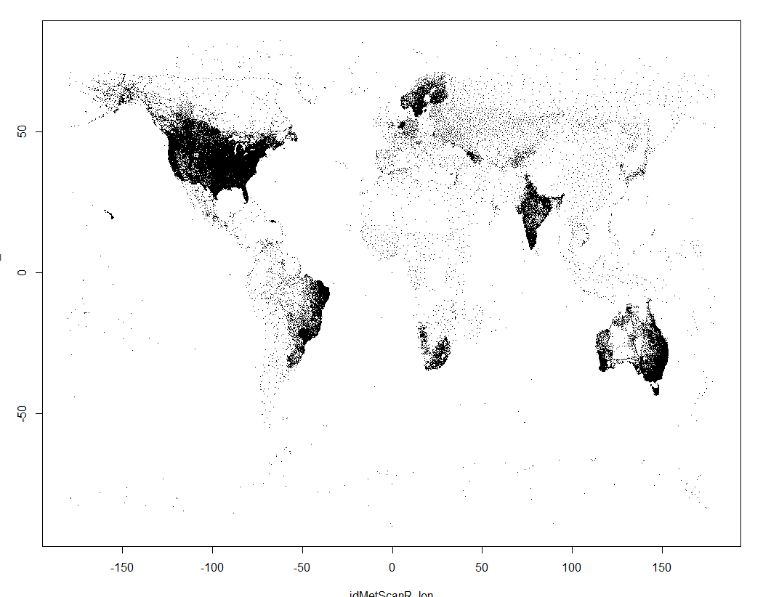
metScanR
A tool for locating, mapping, and gathering environmental data and metadata, worldwide.
Users can search for and filter metadata from >107,000 environmental monitoring stations among 219 countries/territories, worldwide via:
Elevation
Location
Active dates
Elements
Country
Network
Station ID
“NEON’s open-access data, resources and infrastructure will enable scientists, educators, planners, decision makers and the public to map, understand and predict the effects of human activities on ecology and effectively address critical ecological questions and issues.”

Slide 5
metScanR Database
“NEON’s open-access data, resources and infrastructure will enable scientists, educators, planners, decision makers and the public to map, understand and predict the effects of human activities on ecology and effectively address critical ecological questions and issues.”

